Slide 1
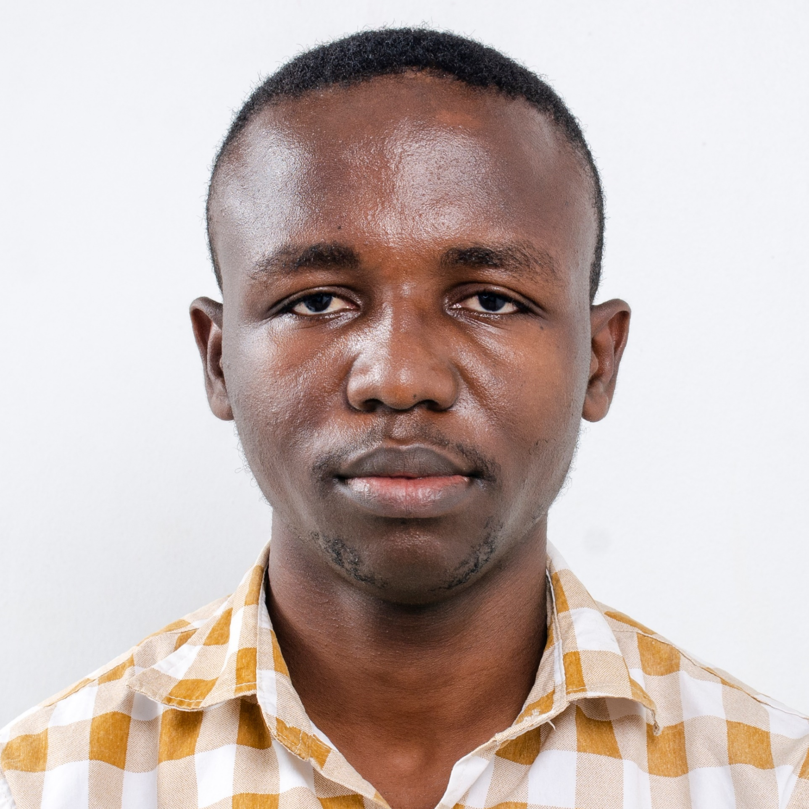
Programming: Operators
Robert Doe
INSTRUCTOR
@bobcumulus www.codeden.org

Slide 2
Operators
“ An operator is a character or characters that determine the action that is to be performed or considered.

Slide 3
Operators
“Operators are symbols that tell the compiler to perform specific mathematical or logical manipulations.

Slide 4
Assignment
“The process or act of giving a value to a variable is known as assignment in programming

Slide 5
Assignment
“The equal sign in Mathematics is known as the Assignment operator
=

Slide 6
Syntax
“An Assignment has two parts:
LHS = RHS

Slide 7
Usage
Container = expression
Container = constant
Container= container
Container= container operator container

Slide 8

A=5
B=10
C=A+B
D=A
5
10
A
B
10+5
15
A
5
C
D

Slide 9
Illustration
yourAge = 17
ageOfBrother = yourAge + 4
ageOfSister = ageOfBrother - 2

Slide 10
Kinds of Operators
Arithmetic / Mathematical Operators
Logical Operators
Relational Operators

Slide 11
Arithmetic Operators
“ An arithmetic operator is a mathematical function that takes two operands and performs a calculation on them

Slide 12
* / %
Multiplication
Division
Modulo
(Remainder)
+ -
Addition
Subtraction

Slide 13
Modulo Operator
7 % 2 = 1

Slide 14

Modulo Operator
$$\frac{7}{2}=3\frac{1}{2}$$

Slide 15
Expression
“ An expression is a combination of operators, constants and variables.

Slide 16
🚫🚫🚫
WE DON’T DO BODMAS HERE

Slide 17
Order of Precedence
“ Precedence, in programming, is the rule that specifies the order in which certain operations need to be performed in an expression.

Slide 18
Order of Precedence
FIRST ORDER
* / %
SECOND ORDER
+ -

Slide 19
A ➔ 🧍‍♂️
B ➔ 🧍‍♀️
A ➔ 2
B ➔ 3
A * B ➔ 👨‍👩‍👧‍👦
A * B ➔ 6
AB / B ➔ 🧍‍♀️ 🧍‍♂️👶👶👶
(AB) / B ➔ (2*3)/3 ➔2 + 0
AB % B ➔ 👶👶👶
(AB) % B ➔ 0
A + B ➔ 🧍‍♂️❤🧍‍♀️
A + B ➔ 2❤3 ➔ 5
A – B ➔ 🧍‍♂️💔🧍‍♀️
A+B – B ➔ 5 💔 3 ➔ 2

Slide 20
Illustration
2/3 + 4%2 + 2+3*2
6/3 + 7 % 2 + 3+ 2/2
1/3 + 1%2 + 1+2/1
-1 / 8 % 3 + 1 % 2 + 1+2/1
-1 /-8 % 2 + 2 % 1 + 1 + 2/1

Slide 21
What is a term in mathematics?
2/3 + 4%2 + 2+3*2 = x
2/3
4%2
2
3*2
x

Slide 22
Operator {* % / + -} | Integer | Decimal or Real
Integer | Integer | Decimal or Real
Decimal or Real | Decimal or Real | Decimal or Real

Slide 23
2/3 + 4%2 + 2+3*2
0
2
6
0
0 + 0 + 2 + 6
8

Slide 24
Relational Operators
“Relational operators allow us compare values to determine if one is greater than, less than, equal to, or not equal to another.

Slide 25
Relational Operators
(Used for comparison)
== < >
Equal to
Less than
Greater than
<= >= !=
Less or equal
Greater or equal
Not Equal

Slide 26
Logical / Compound Operators
“ A logical operator is a symbol or word used to connect two or more expressions such that the value of the compound expression produced depends only on that of the original expressions and on
the meaning of the operator.

Slide 27
Logical / Compound Operators
&& || !
AND OR NOT

Slide 28

Activity
Write the output for the following expressions
PTO

Slide 29
Questions
10/3 + 15%3 + 2 + 4*2
19 % 3 + 11 % 3 + 7*3 + 4*2
11/3 + 10 % 3 + -5 + 7 * 1
10 / 3 + 21 % 20 + 2 + 10*2
110 / 4 + 15 % 3 + 21 + 41 * 2
11 % 4 % 2 + 15 *3 % 3 + 21 + 41 * 2

Slide 30
robertdoe@codeden.org

